Slide 1
Finding Parts of the Page

Slide 2

Traditional DOM Selection

Slide 3

HTML5 DOM Selection

Slide 4
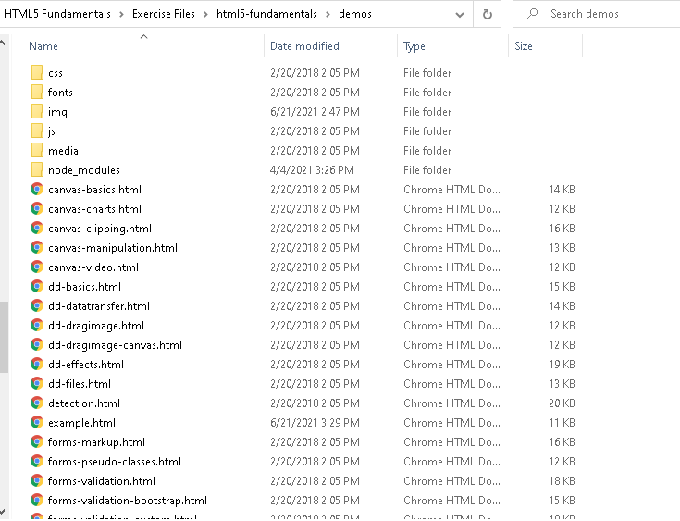

Slide 5
Demo
Selection API

Slide 6

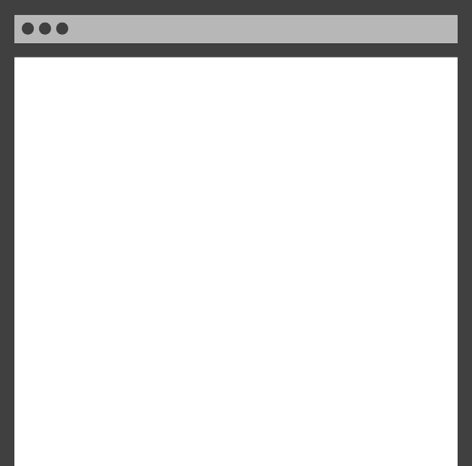
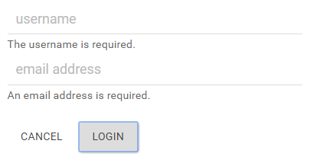
Next Module
Working With User Input

Slide 7

Summary
Finding Parts of the Page
Native DOM selection Fast & Flexible
Uses selectors

